Slide 1
Analysis & Exploration of Aircrash Data
By :
Dhruv S
Ravi P
Pratyanush G

Slide 2
Aim
In this Project we import a csv file into Mongo DB using the Mingoimport command
After importing the data , we clean this data by removing Null values and renaming a few columns
The next step is to make Mongo DB connect to our python front end.
The front-end is used to run Mongo Query :CREAT, READ, UPDATE , DELETE.
After data is entered into Mongo DB using front-end we visualize various histograms of data etc.

Slide 3
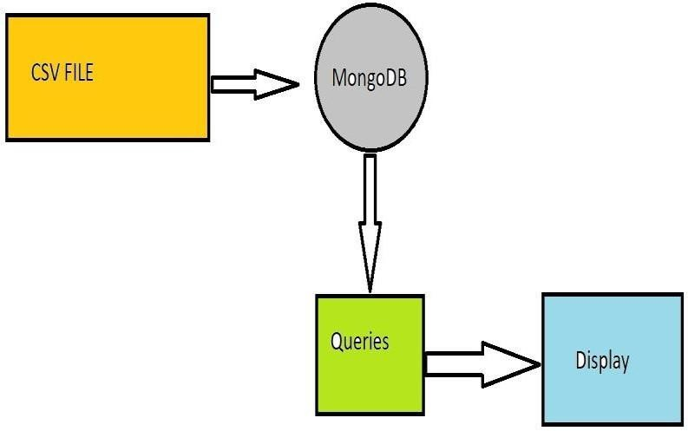
DESIGN

Slide 4
Quries
1.
db.air.insert({uid:”ID12101”,loc:”dubai”,date:”12-8-2012”,op:”indigo”,planetype:”boeing”,dead:”45”,aboard:”150”,ground:”0”})
db.air.update({id:”ID12107”},{$set:{aboard:”90”}})
db.air.delete({id:”ID12110”})
db.air.read({id:”ID12102”})

Slide 5
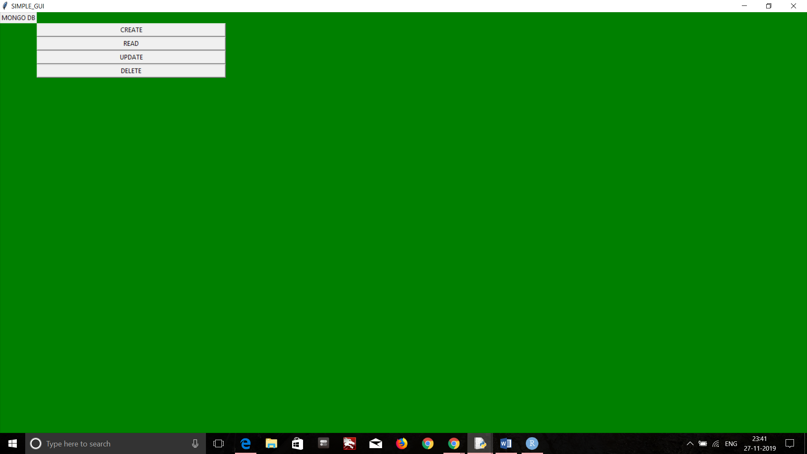
Results

Slide 6
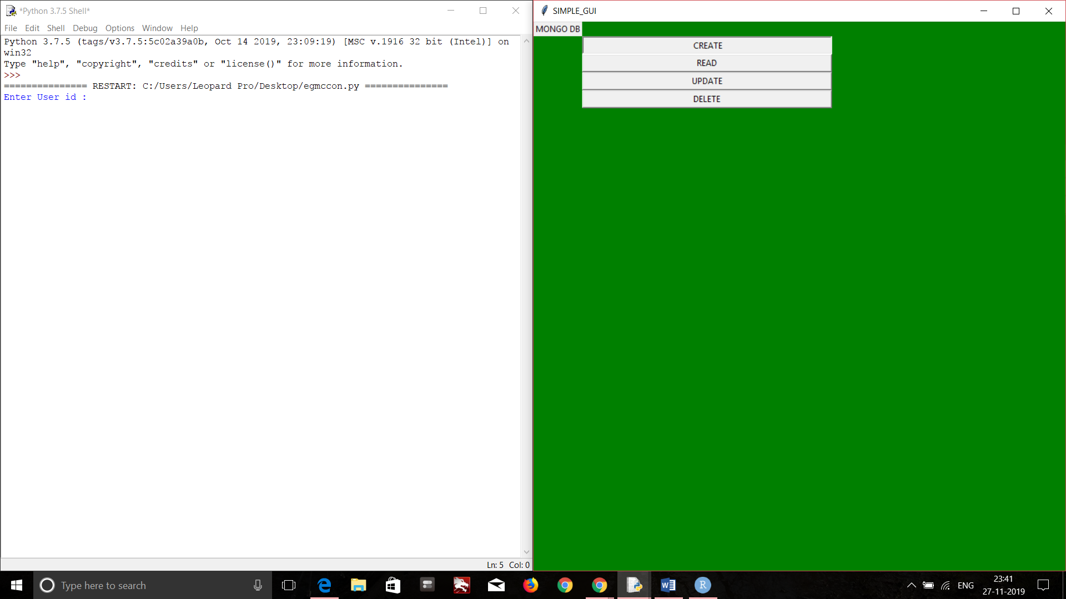

Slide 7


Slide 8
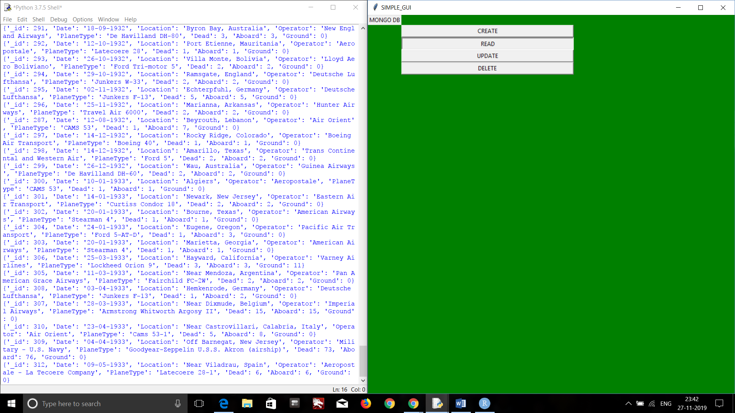

Slide 9


Slide 10


Slide 11
